Slide 1
Structured Volume Sampling
Huw Bowles, Daniel Zimmermann, Beibei Wang
August 2017

Slide 2
Background
Volume rendering expensive
Sample counts severely limited
Aliasing problems

Slide 3
Previous work - WIP
Volumetric fog
Cache lighting and density in frustum aligned volume texture, with reprojection
Bart Wronski - link
TAA
Raymarch with very few samples, supersample across frames
Mikkel Gjoel - presentation pptx online: link
Killzone Volumetric lighting
Raymarch at low resolution for lighting
Render particles in frustum aligned volume texture to give detailed texture to density
Michal Valient - slides: link
Notes:
https://twitter.com/EpicShaders/status/868144777472114692
http://advances.realtimerendering.com/s2014/wronski/bwronski_volumetric_fog_siggraph2014.pdf
https://www.ea.com/frostbite/news/physically-based-unified-volumetric-rendering-in-frostbite
Killzone talk

Slide 4
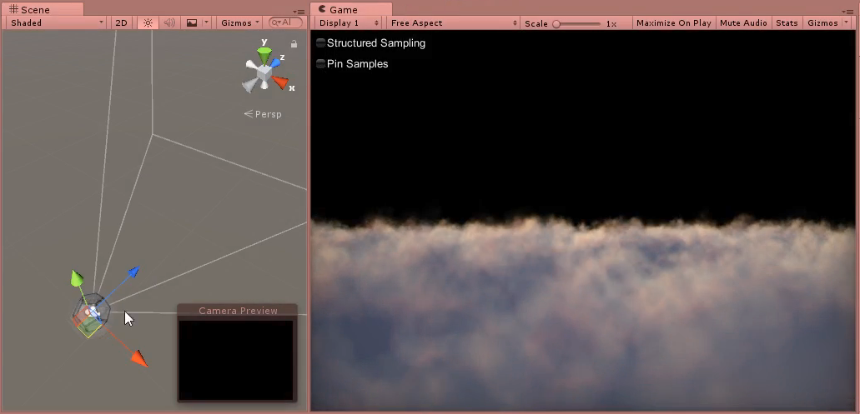
Sampling problem
Notes:
Traditional raymarching (beginning of video):
Crazy aliasing when camera moves
Sideways is ok
Forwards motion - aliasing
Forward pinning (from our talk in the Advances course 2015: http://advances.realtimerendering.com/s2015/index.html ) - we can pull samples towards viewer to compensate for forward motion. This is fixing translational motion in view space.
Forward motion – fixes aliasing when moving forward
Rotation – still aliases
Summary:
Sideways works
Rotation – sample planes sweep through volume
See previous talk for details
Video: VolSamplingCapture (first 45s)

Slide 5
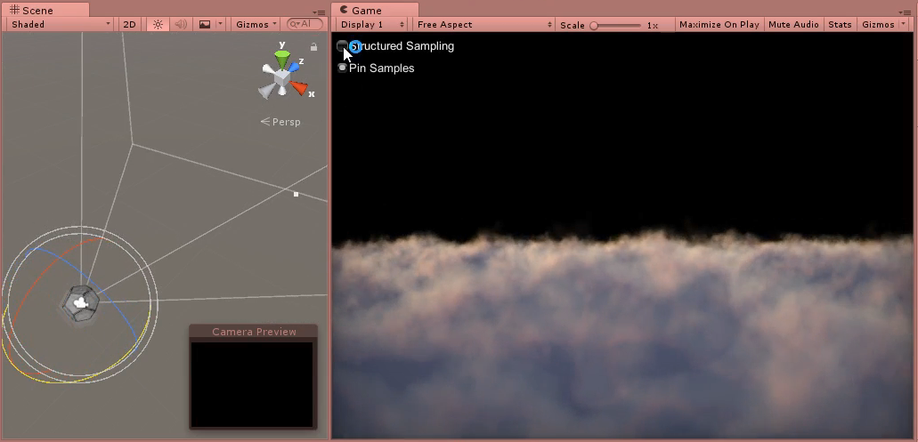
Sampling problem
Notes:
New approach – fix all types of motion in by holding sampling in WORLD space. Instead of having a set of slices in view space, have sets of slices in world.
Easiest way to understand this is to see render, lets look at the case where there is a set of sampling planes parallels to the XY plane, and all samples are taken from these:
Result looks good when looking into planes
Rotate camera away from planes – result looks weird – need to fix this
But looking at the planes, result is solid, both translational and rotation, until we rotate too far away from facing the planes. Fix this next..
Video: VolSamplingCapture (latter part of video – after 45s)

Slide 6
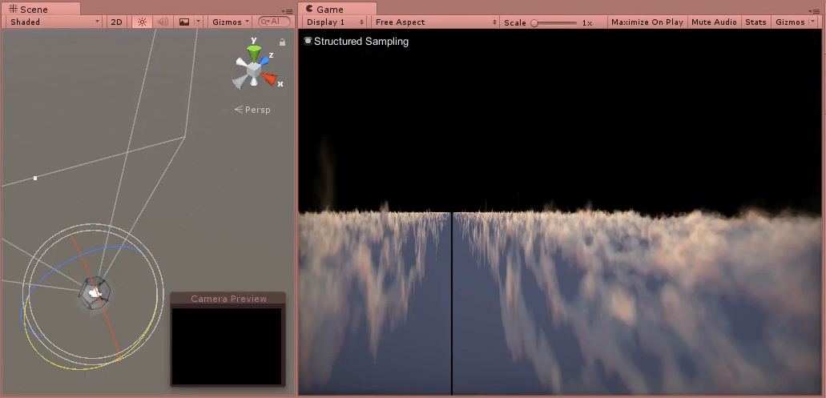
Structured Sampling
Notes:
We avoid views like this the one shown by blending in to a different sample plane orientation.
All planes shown here are orthogonal to Z axis. Let’s introduce more sets of planes at additional orientations and blend between them based on ray direction.
Robust, alias free result. No edge cases.
Video: VolSampleStructured

Slide 7
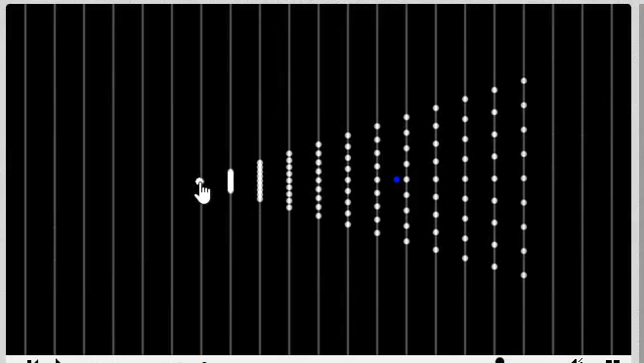
Structured Sampling
Notes:
Lets look at a top down view of the sampling, to reinforce the ideas so far.
This is a visualisation of the volume samples from a top down point of view. Sample planes shown in gray.
Video: SampleDiagram01

Slide 8
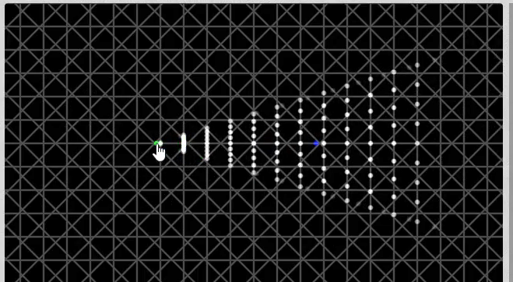
Structured Sampling
Notes:
Here we add sample planes for additional orientations.
Video: SampleDiagram02

Slide 9
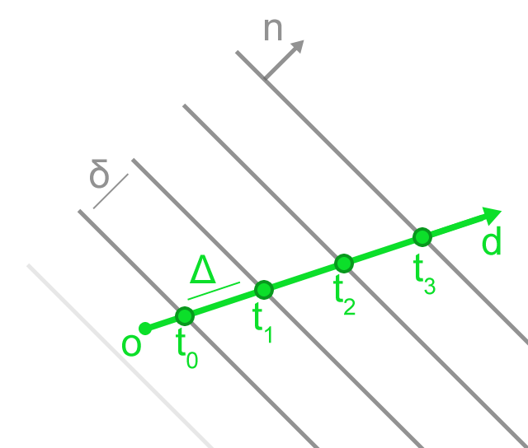

Structured Sampling
Find plane orientation(s) $n_{i}$ for ray (o, d)
Compute $t_{0}$ and $∆$, march ray
Notes:
A quick note on how to march a ray against 1 set of planes.
The runtime calculation is relatively simple once we know the orientation.
Delta and t0 need to be computed once – constant time.

Slide 10
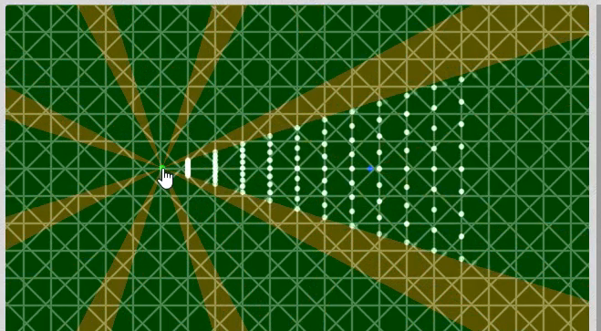
Structured Sampling
Notes:
At the blend areas, 2 rays have to be marched – show in yellow.
Video: SampleDiagram03

Slide 11
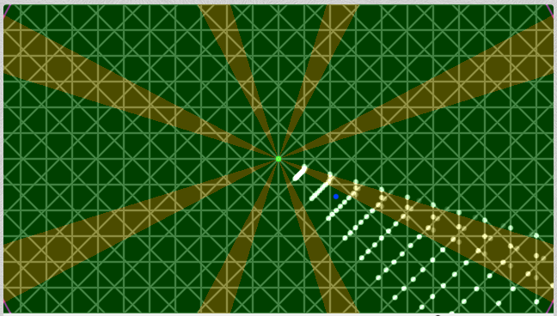
Seed Geometry
Notes:
In order to minimize runtime overhead, we use geometry to seed the raymarch with information about the plane set(s) it will be raymarching against.

Slide 12
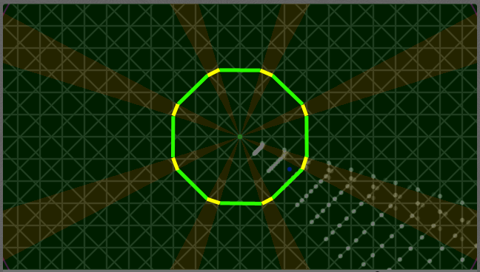
Seed Geometry – 2D
Notes:
For flatland 2D: Bevelled octogon, rendered around viewer position.
Geometry carries information about which planes to intersect.
Covers all range of flatland view directions.
Bevel width defines blend region.
Shader specific to case (1 ray shader vs 2 ray shader). Decision is static.

Slide 13
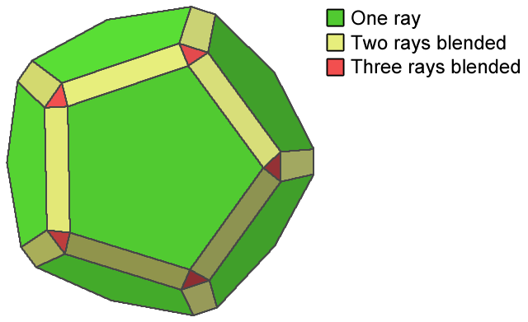
Seed Geometry – 3D
Dodecahedron
Irregular(ish)
Good distribution of faces
Max. 3 faces intersect
Notes:
3D case - Any sealed geometry covering sphere of view directions around the camera would work.
But if 4 planes meet at a point, we’ll need to march all 4, so try to minimize these cases.
Pick Dodecahedron
Each green face corresponds to a set of sample planes. Yellow, red.
TODO percentages of each.

Slide 14
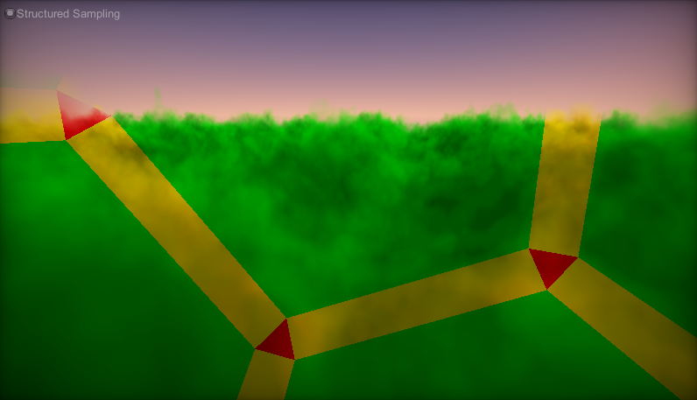
Seed Geometry – 3D
Render colour coded
Notes:
Visualisation showing which shader is executed for each pixel for an example view.

Slide 15
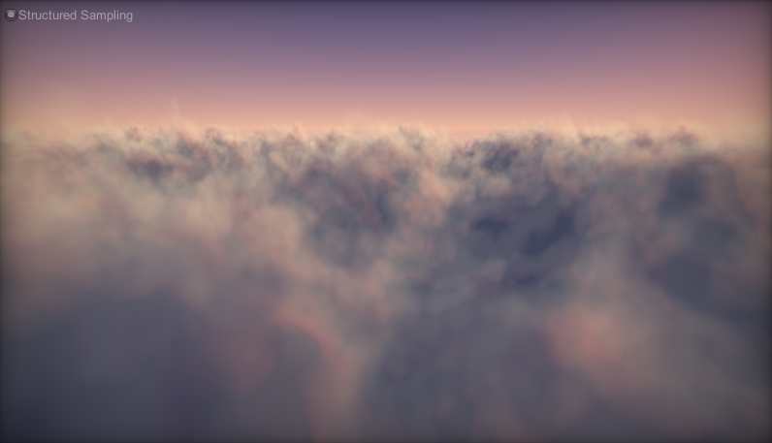
Result
Render final
Notes:
Result

Slide 16
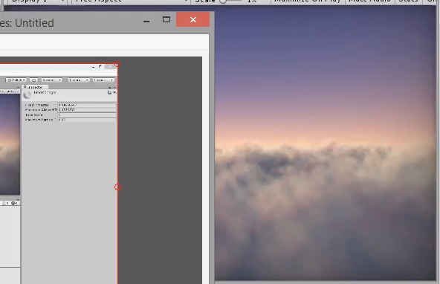
Result
Notes:
Result video – currently way too small/crap: CloudsResult

Slide 17
Results
Renders clouds really well
What about other scenes?
Problems at medium - high freqs
Error stable, but still visible

Slide 18
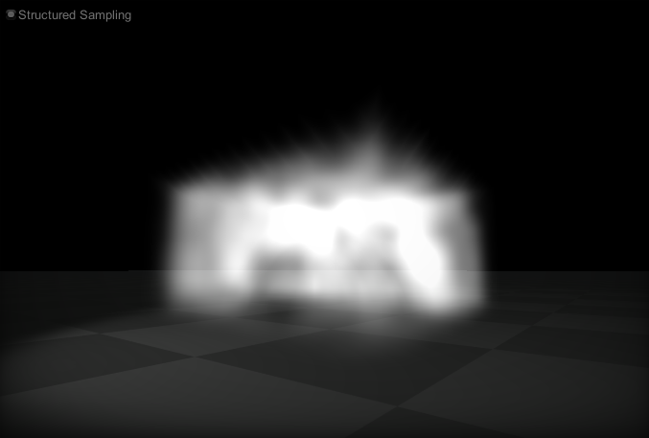
Results
Fog cube
Needed large feather at boundaries
Intersections with opaque surfaces
Soft particles
Notes:
This scene is in the volsample repos.
This screenshot looks “ok”, but this was after a bunch of hacking to make the cube really soft, and even now there are jagged artifacts at the top of the volume, which is revealing the sample planes.
No video etc yet.

Slide 19
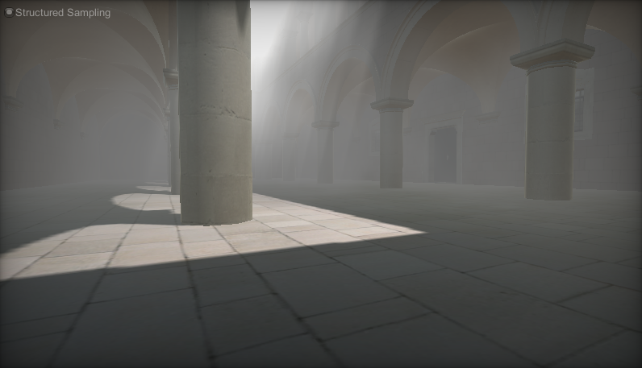
Results
Sponza (McGuire)
Lighting adds hi-freq
Address by low shadow map res and smooth visibility function
Notes:
This scene is available in the open source repos.
I did a lot of hacking with the way we computed shadows to make a smooth shadow function.
This looks “ok” in some scenarios but easily breaks down.
No video etc yet.

Slide 20
Github
MIT licensed Unity project with all results
https://github.com/huwb/volsample

